Slide 1
Cloud computing & AWS
→Team aws era

Slide 2
Cloud computing
It is the on-demand availability of Computer System Resources, especially data storage & Computing power without direct active management by the user.
TYPES
→Public cloud – AWS,AZURE,GCP
→Private cloud - VMWARE,OPEN STACK,HYPER V
→Hybrid cloud – PUBLIC & PRIVATE

Slide 3
AWS
AWS-It stands for Amazon Web Services
Its also known as Cloud Computing System and one of the Public Cloud Platform.
It Works based on Regions & Availability Zones.
REGIONS & AVAILABILITY ZONES
→It is hosted in multiple locations world-wide.
→Each Region is made up of two (or) more Availability zones.
→AWS has 20+ Regions world-wide.
→Each Region is completely independent and Each Availability Zone is isolated.

Slide 4
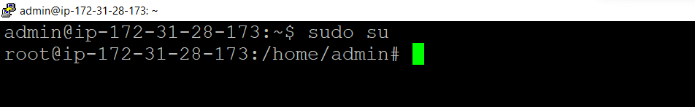
SERVICE MANAGEMENT IN LINUX
Sudo su – It allows users to run programs with the security privileges of another user.

Slide 5
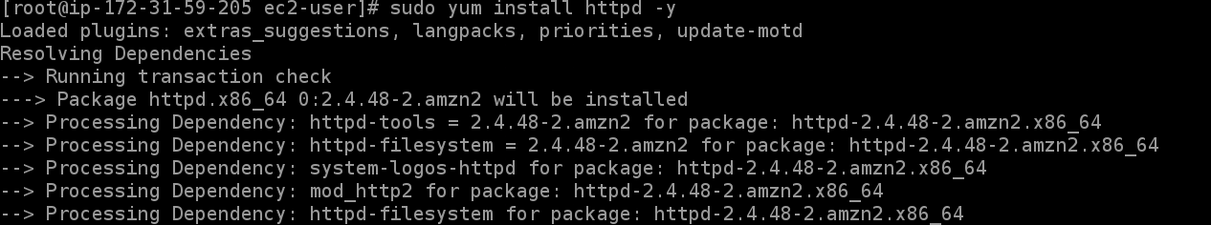
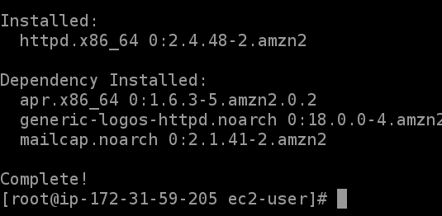
Yum install httpd –y –> http service install command

Slide 6
Service httpd start –
Sudo chkconfig httpd on -

Slide 7
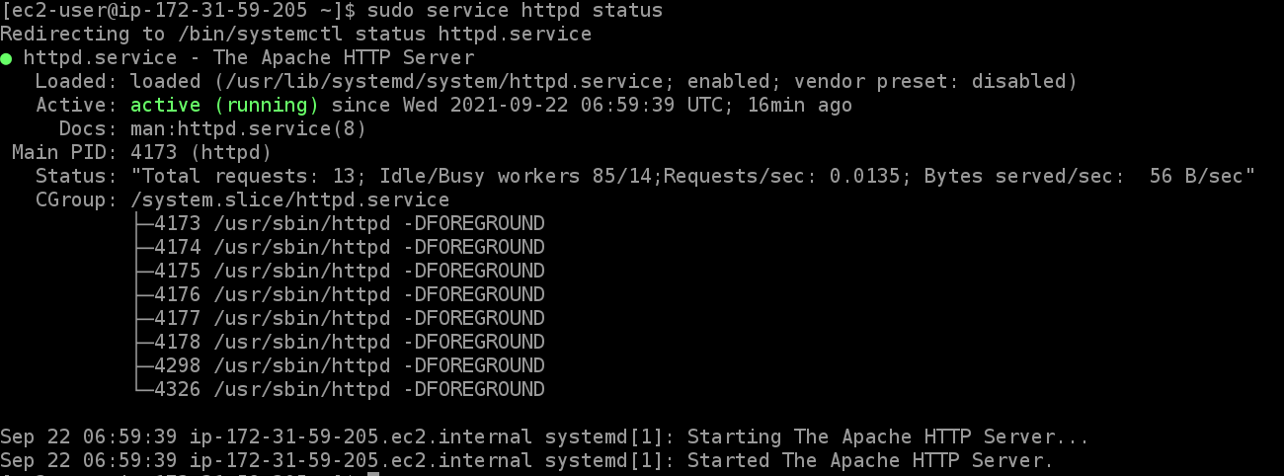
Sudo service httpd status -

Slide 8
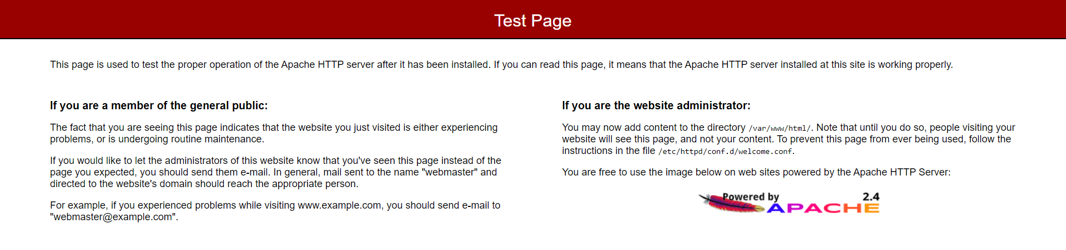
output

Slide 9
Enable (or) Disable the service
Command→systemctl enable servicename.service
Enable→Using the enable command, we can modify how the systemd service responds once the server has been started or rebooted. It will update the service settings, which then tells systemd that the specific service needs to start up automatically, once the server is up. The command to accomplish this is as follows.
Command→systemctl reload-or-restart servicename.service
Disable→While most of the services like HTTPD, MySQL, MariaDB, etc. will have already automatically started, we may need to enable the automatic startup for some of them manually. Similar to how we can set a service to automatically start when the server boots up, we can also disable a service using the following command.

Slide 10
THANK YOU

